Slide 1
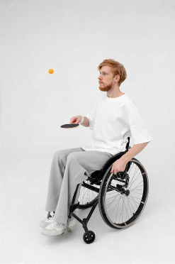
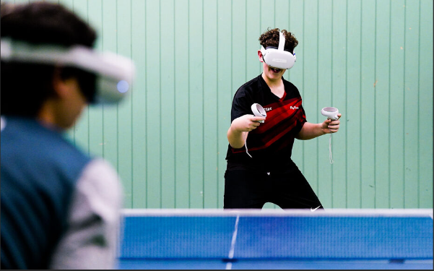
Wheelchair Ping Pong
Use Cases
Group 3
Luca Irimie, Sebastian Kuka, Paul Murariu, Leia Sayed

Slide 2
Introduction
The VR Wheelchair Ping Pong project develops an immersive game where wheelchair users compete against AI in ping pong.
With realistic physics and responsive controls, the game simulates playing ping pong with mobility restrictions.
This project enhances VR accessibility, offering a fun experience for players of all skill levels.

Slide 3
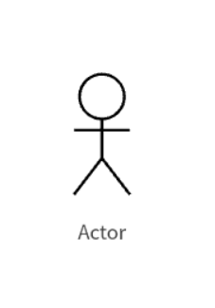
Actors
Player/User - Person who is interacting with the game’s system to perform actions within the game’s environment.
Database - Holds player login credentials as well as player statistics.

Slide 4
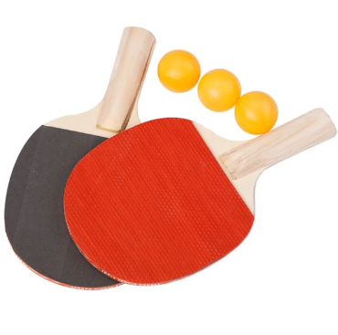
Use Case List
The VR Wheelchair Ping Pong project will have a total of five unique cases
3.1 Player Registration
3.2 Set AI Opponent Difficulty
3.3 Select Game Type
3.4 Player Mechanics
3.5 Quit Game

Slide 5
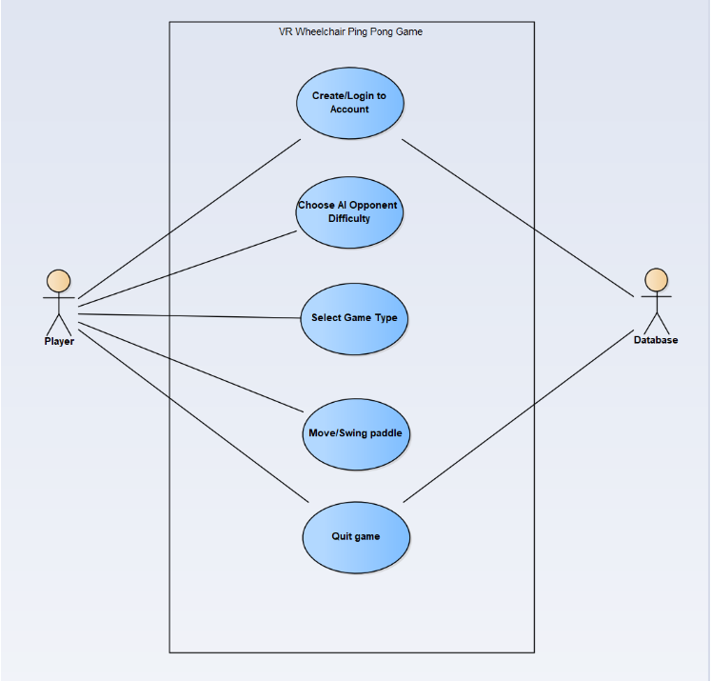
Use Case Diagram

Slide 6
Use Case Summary
Player Registration lets users create or select a profile, storing preferences and scores. Afterward, they choose opponent difficulty and game type.
Set AI Opponent Difficulty lets players choose between beginner (stationary) and advanced (mobile, skilled) AI for a balanced game experience.
Game Type Selection lets players choose between tutorial (practice) and match mode (vs. opponent) for casual or competitive play.
Player Mechanics let users control the wheelchair and ping pong paddle in VR with intuitive controls, using a VR headset for view tracking and VR hand controllers for the movement.
The Quit Game option lets players exit anytime, save progress, and confirm their choice to resume, return to the main menu, or fully exit the game.

Slide 7
Challenges
Determining what the use cases would be in the first place and making sure we did not have too little or too many use cases
Designing the game to be accessible for wheelchair users, balancing realistic movement restrictions with a smooth, enjoyable experience.
Accounting for the limitations of using the VR equipment such as the cable for it not being very long which restricts the user to a small amount of space to move around in.

Slide 8
Conclusion
In conclusion, the purpose of the VR Wheelchair Ping Pong game is to place a strong emphasis on player involvement through adaptive AI and intuitive controls. Our use case summary and analysis is meant to allow for the smooth integration of important features like the actions of the player, the difficulty of the AI opponent, and storing important information for the players such as their score. This project is looking to create an immersive and accessible virtual reality gaming environment by combining the gameplay experience with carefully decided and specific business rules and technical specifications as well.

